Slide 1

Credit Card & Fraud Detection

Slide 2
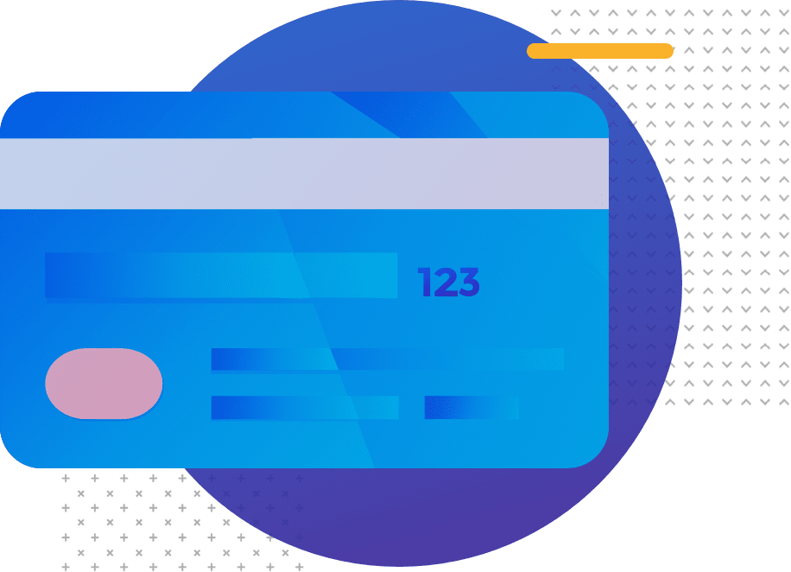
Content :
Data Collection
Data Preprocessing
Feature Engineering
Data Splitting
Model Selection
Model Training
Model Evaluation
Tuning and Optimization
Deployment
Real-time Monitoring
Feedback Loop
Human Intervention

Slide 3

Introduction:
Credit card fraud detection using data science involves analyzing transaction data to identify and prevent fraudulent activities. Here's a high-level overview of the process.

Slide 4
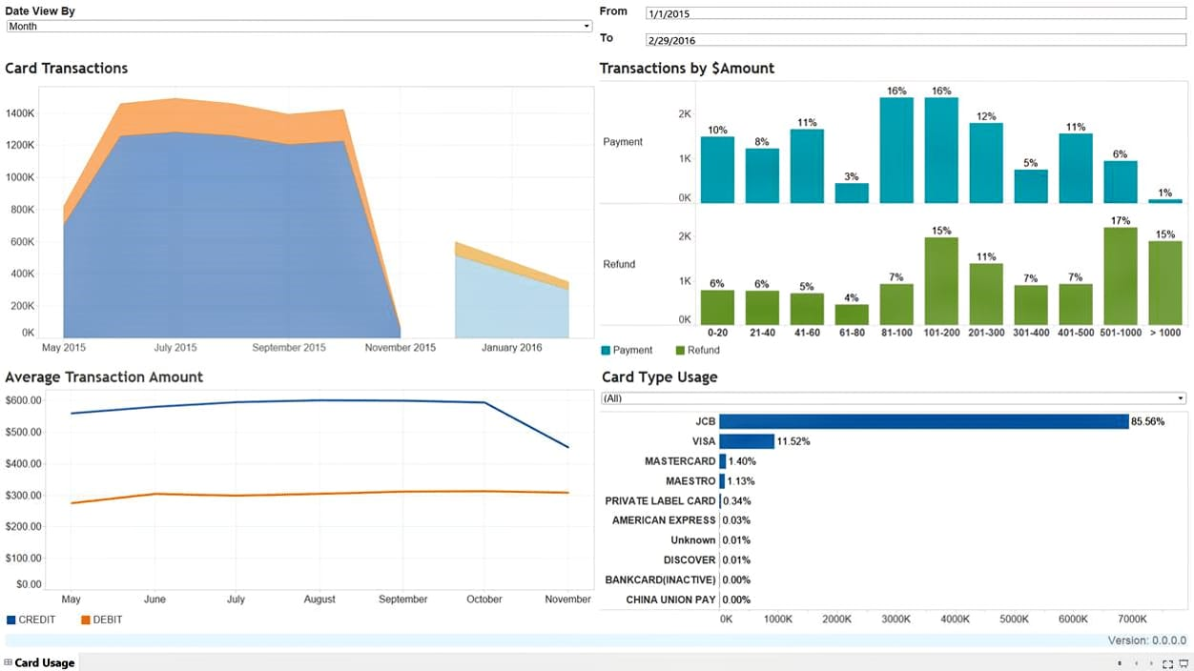
Data Collection:
Gather historical transaction data, including details such as transaction amount, location, time, and user information.

Slide 5
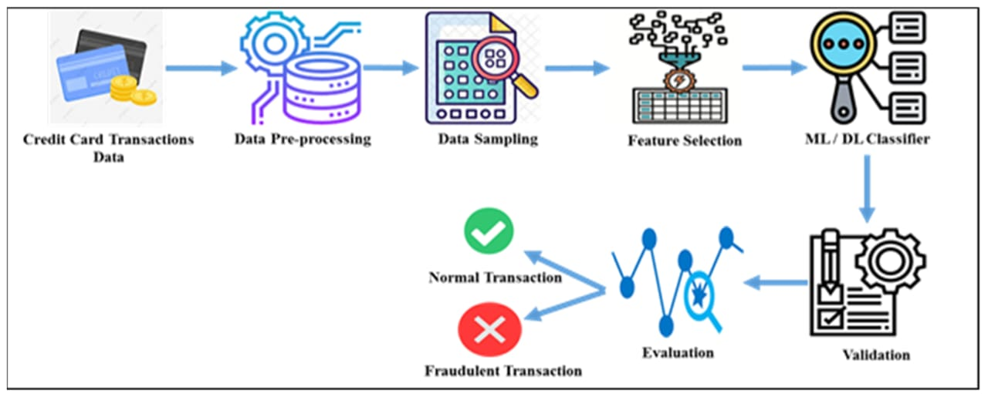
Data Preprocessing:
Clean and preprocess the data by handling missing values, outliers, and formatting issues. This step is crucial for accurate analysis.

Slide 6
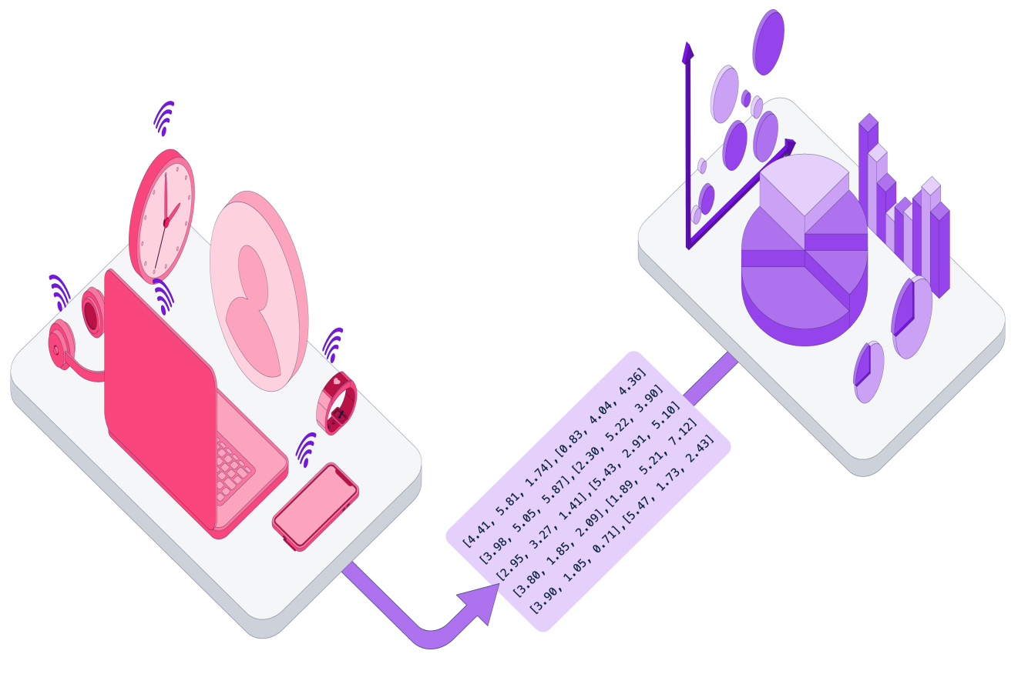
Feature Engineering:
Create relevant features that can help in fraud detection. Features might include transaction frequency, transaction amount patterns, and user behavior.

Slide 7
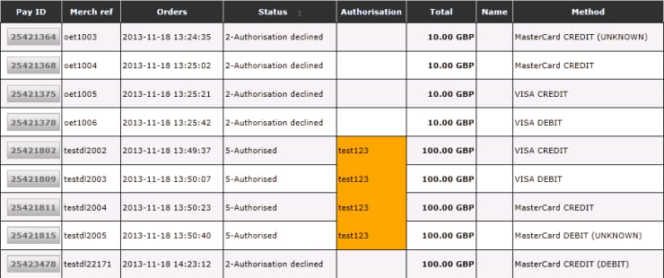
Data Splitting:
Split the data into training and testing sets to evaluate the model's performance.

Slide 8
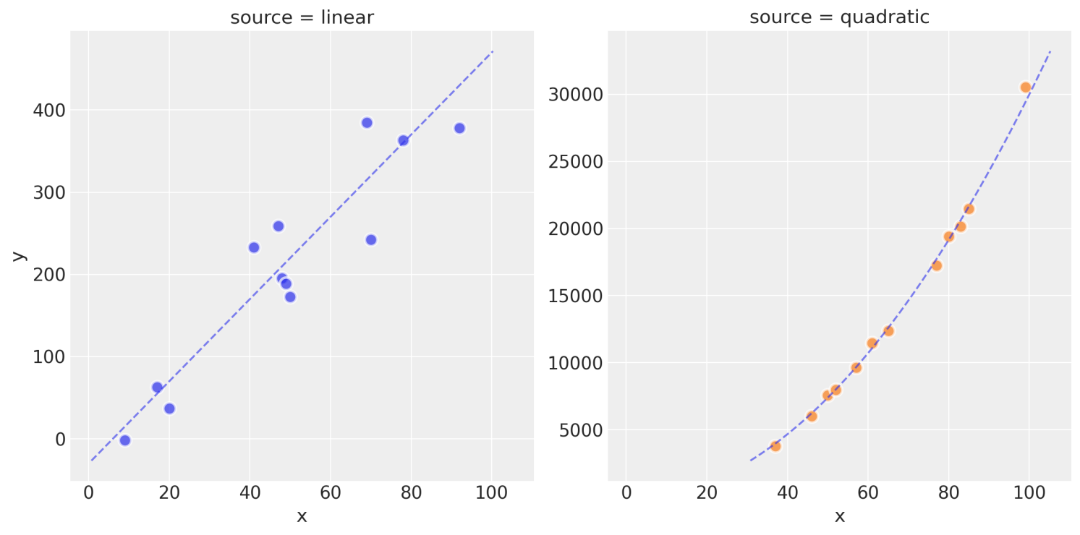
Model Selection:
Choose appropriate machine learning or deep learning algorithms for fraud detection. Common choices include logistic regression, decision trees, random forests, and neural networks.

Slide 9

Model Training:
Train the selected model using the training data. The model learns to distinguish between legitimate and fraudulent transactions.

Slide 10

Model Evaluation:
Evaluate the model's performance using the testing data. Common evaluation metrics include accuracy, precision, recall, and F1-score.

Slide 11
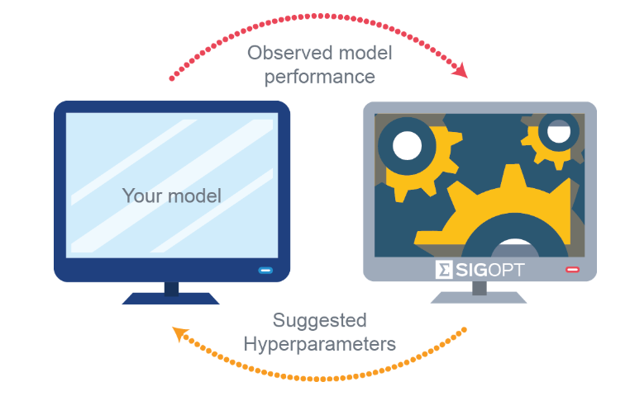
Tuning and Optimization:
Fine-tune the model parameters and algorithms to improve performance. Techniques like cross-validation and hyper parameter tuning can be used.

Slide 12

Deployment:
Once satisfied with the model's performance, deploy it in a production environment to monitor and analyze incoming transactions in real-time.

Slide 13

Real-time Monitoring:
Continuously monitor transactions for suspicious patterns or anomalies. If the model detects a potentially fraudulent transaction, it can trigger alerts for further investigation.

Slide 14

Feedback Loop:
Periodically update the model with new data to adapt to changing fraud patterns. This ensures that the model remains effective over time.

Slide 15
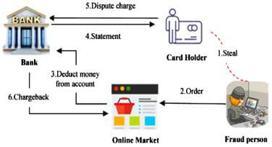
Human Intervention:
In some cases, human experts may be involved to review and confirm suspicious transactions flagged by the model.

Slide 16

Conlution:
Data science and machine learning play a crucial role in improving the accuracy and efficiency of credit card fraud detection systems, helping financial institutions protect their customers from fraudulent activities.

